Slide 1

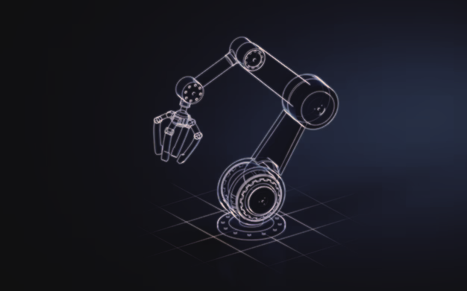







Robotics Mini Project
Kinematic Analysis of a Robot Arm
Group
Members
A. D. Upeksha Dilhara
D. R. P. Abeyarathne
W. K. D. Dilan Senuruk

Slide 2




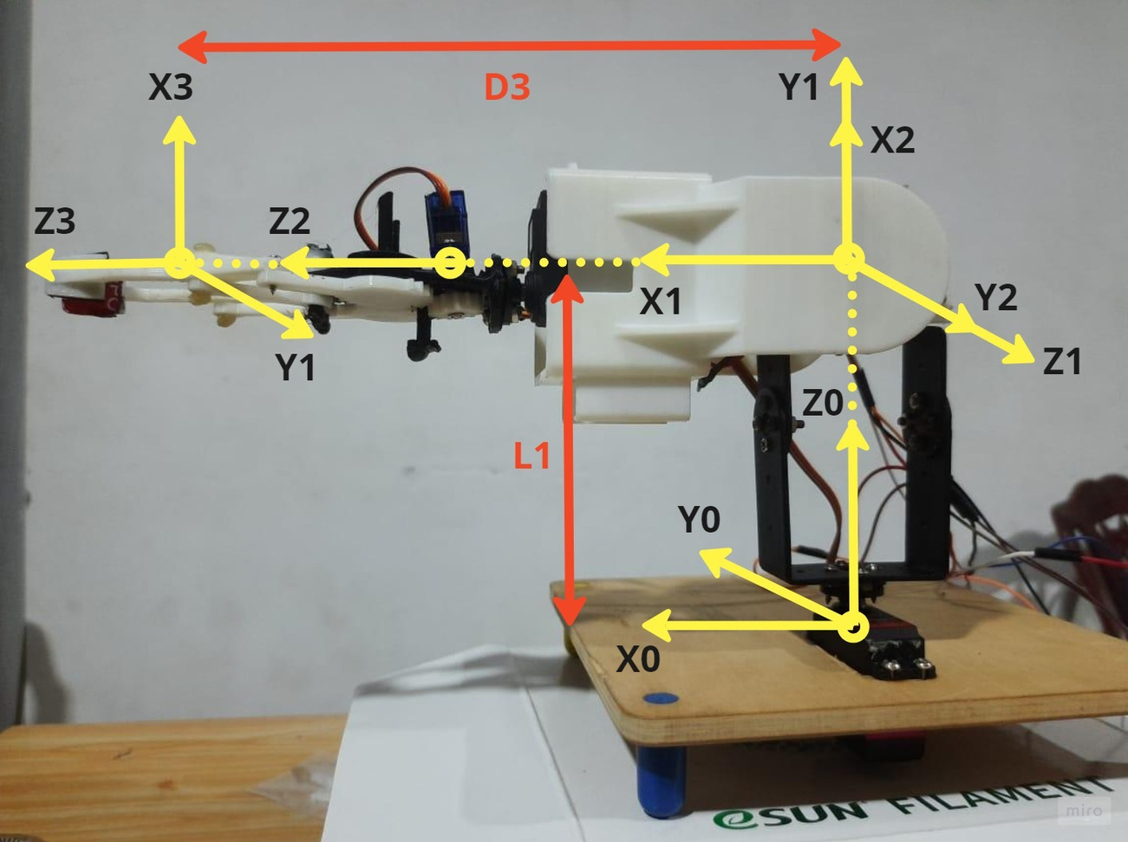

FRAME ASSIGNMENT

Slide 3

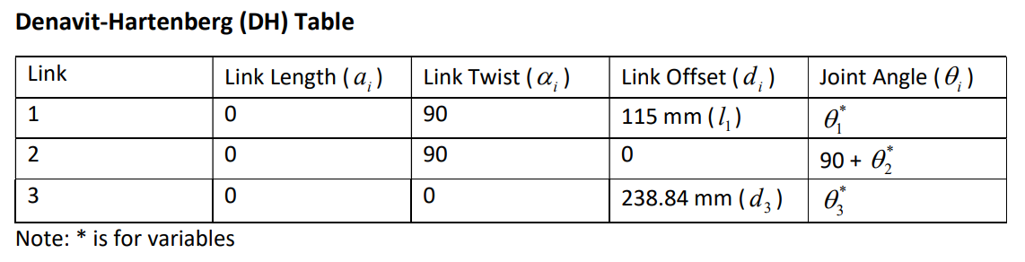


DH TABLES

Slide 4

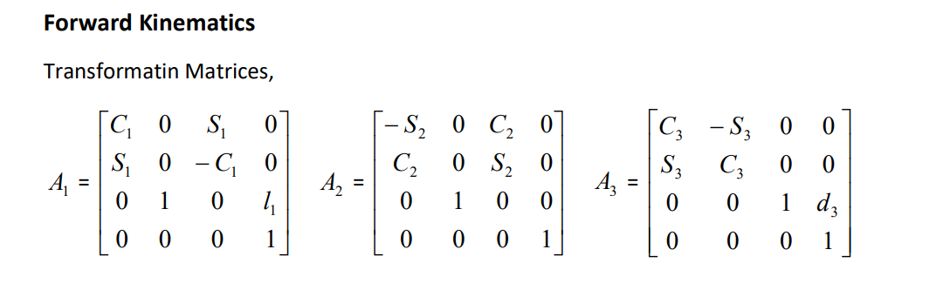
Forward Kinematics

Slide 5


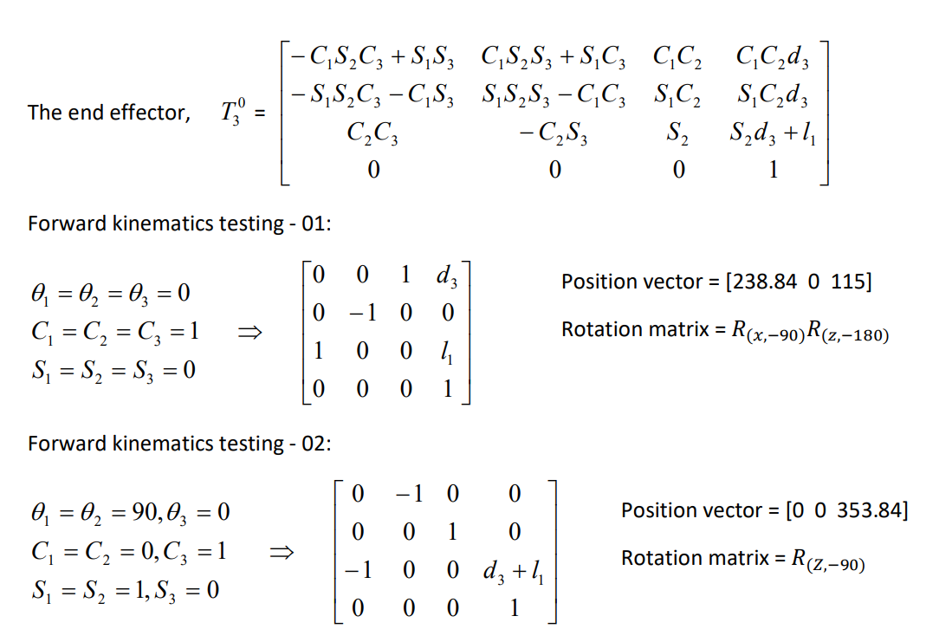

Slide 6


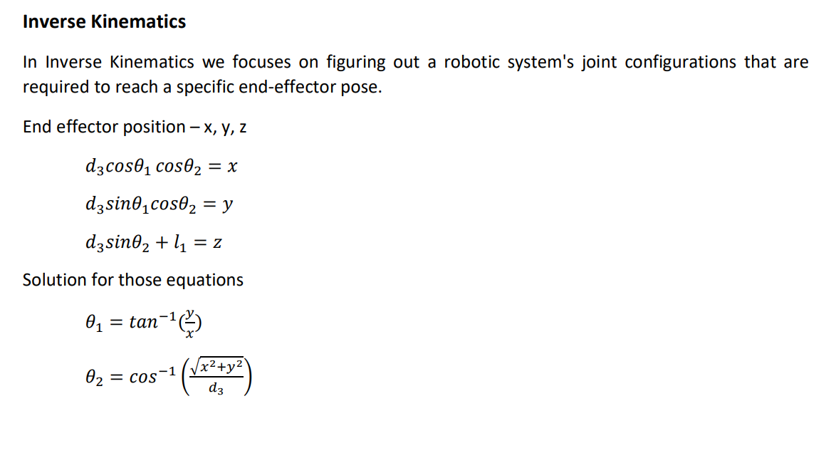

INVERSE KINEMATICS

Slide 7
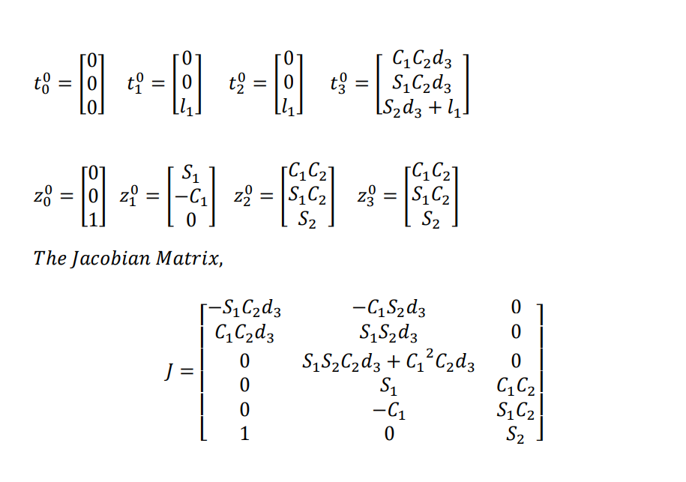
MANIPULATOR JACOBIAN

Slide 8
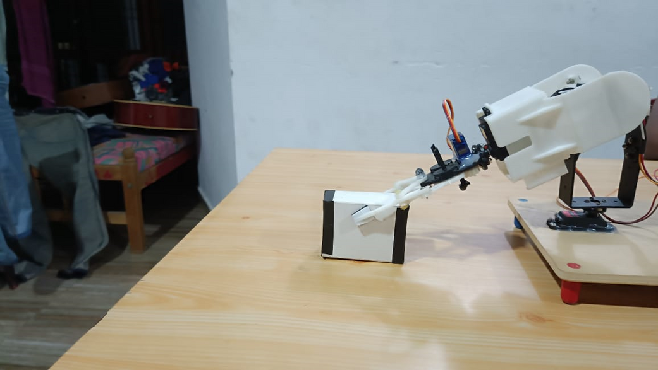
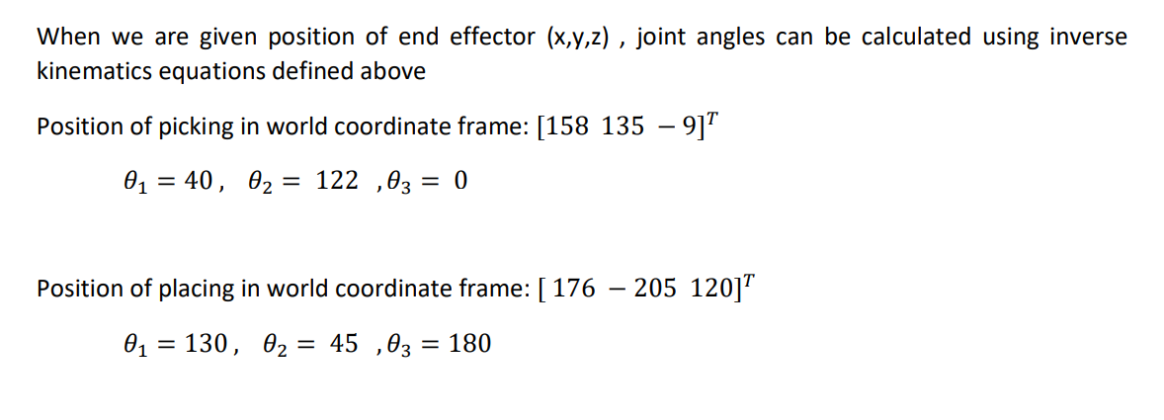

Pick and Place Task

Slide 9
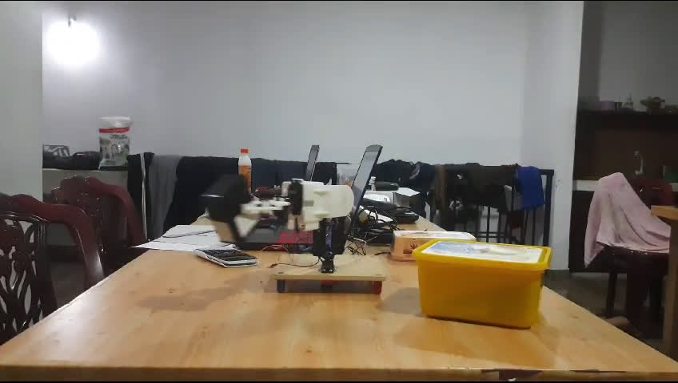

Slide 10
THANK YOU!

